Slide 1
Obtaining patent data from PATENTSCOPE
Manila
7 November 2017
Irene Kitsara, IP Information Officer
Access to Information and Knowledge Division

Slide 2
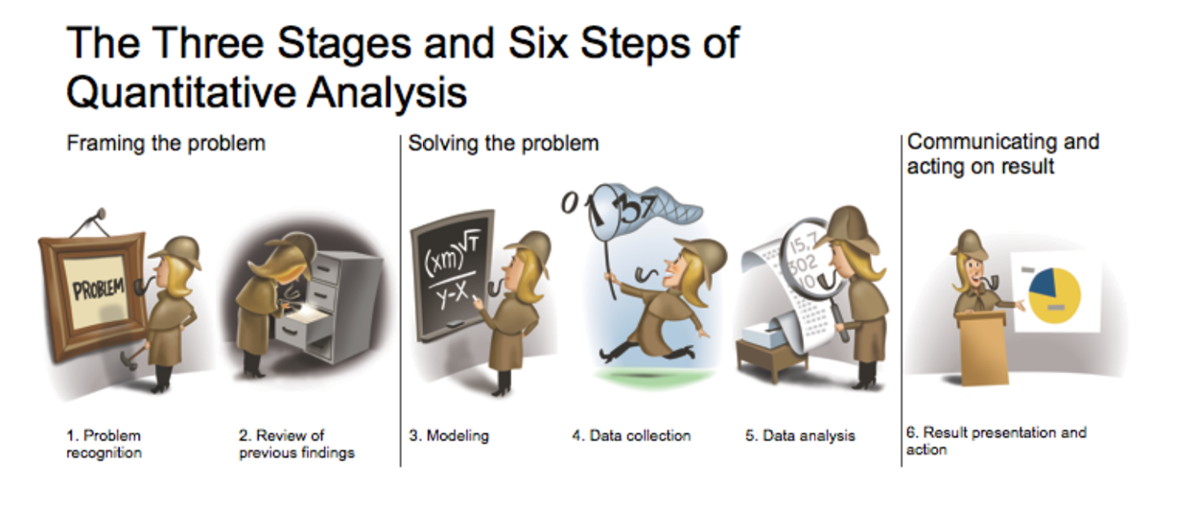
The patent analysis quest
Keeping Up with the Quants, Davenport & Jinho Kim, Harvard Business Review Press, 2013
Good questions – increased chances for good answers
Good quality of data – good quality of analysis
Where is the data?

Slide 3





Data sources
Non-patent data
Patent data
Primary source of information
Patent Gazettes/Bulletins....
Secondary sources of information
PATENTSCOPE
Esp@cenet
The Lens
Other free databases
Commercial Databases...

Slide 4
The importance of obtaining data
Right source of information
Understanding of parameters and limitations of the source
Confidentiality issues?
Where will the data feed into?
Is my data format compatible with the tool I want to use to clean/tidy/analyze and visualize the data?

Slide 5
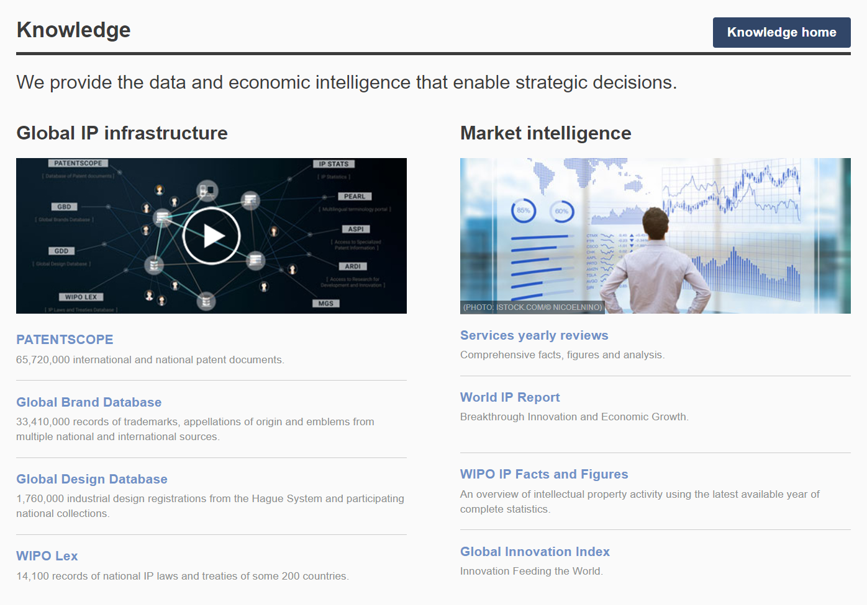
PATENTSCOPE: Access point
www.wipo.int

Slide 6
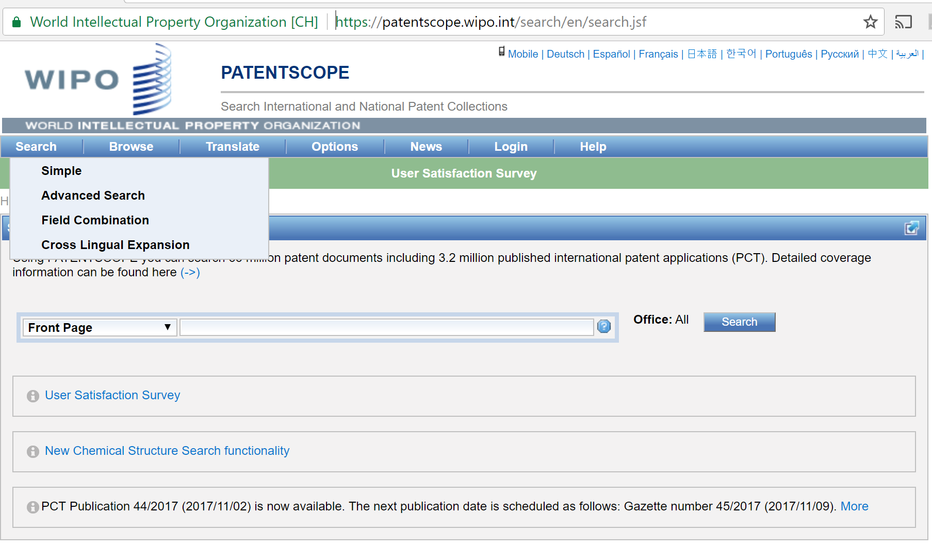
PATENTSCOPE and its search functionalities
66 million patent documents (regional and national collections)
3,2 million published PCT applications
https://patentscope.wipo.int

Slide 7
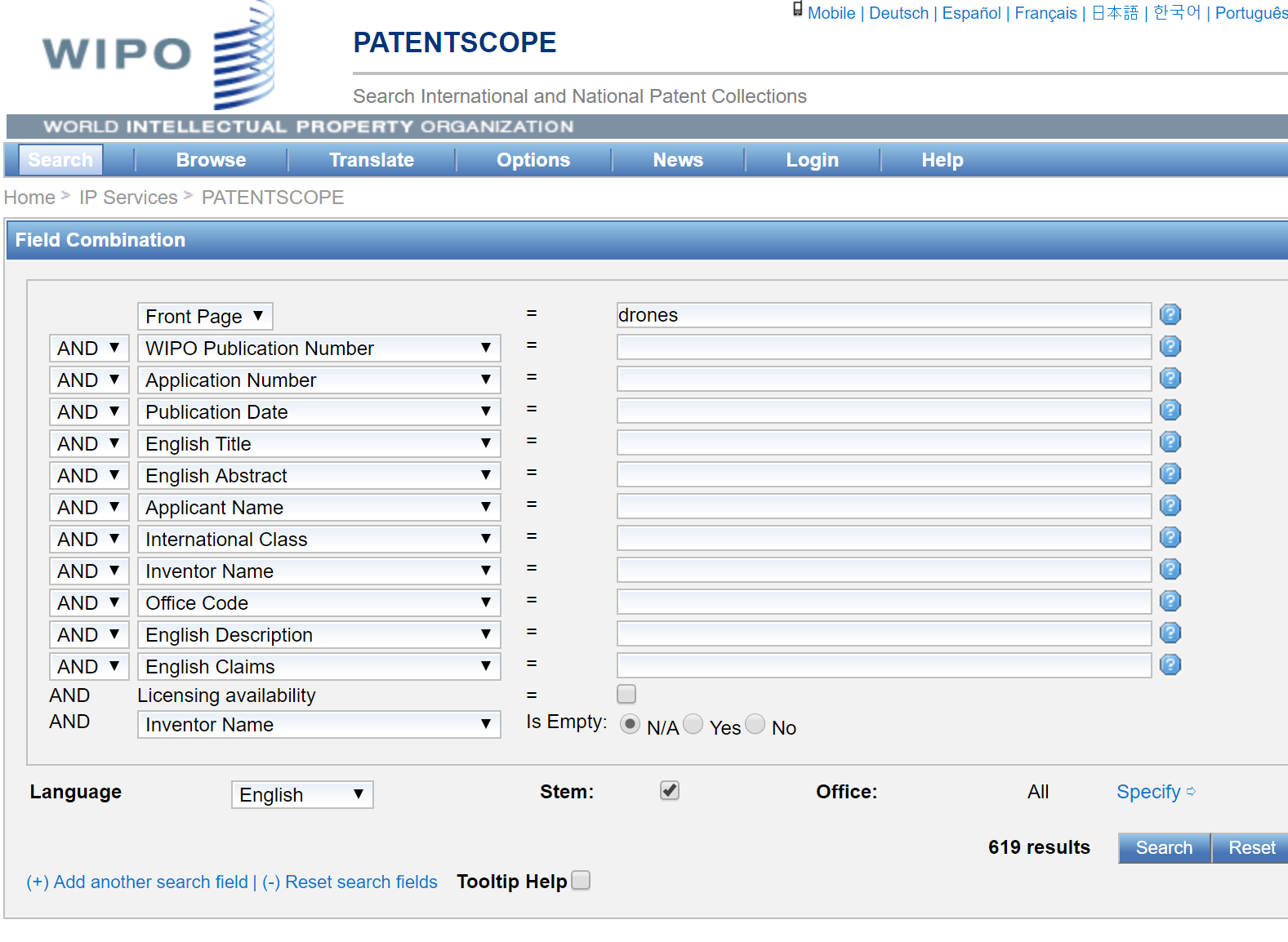
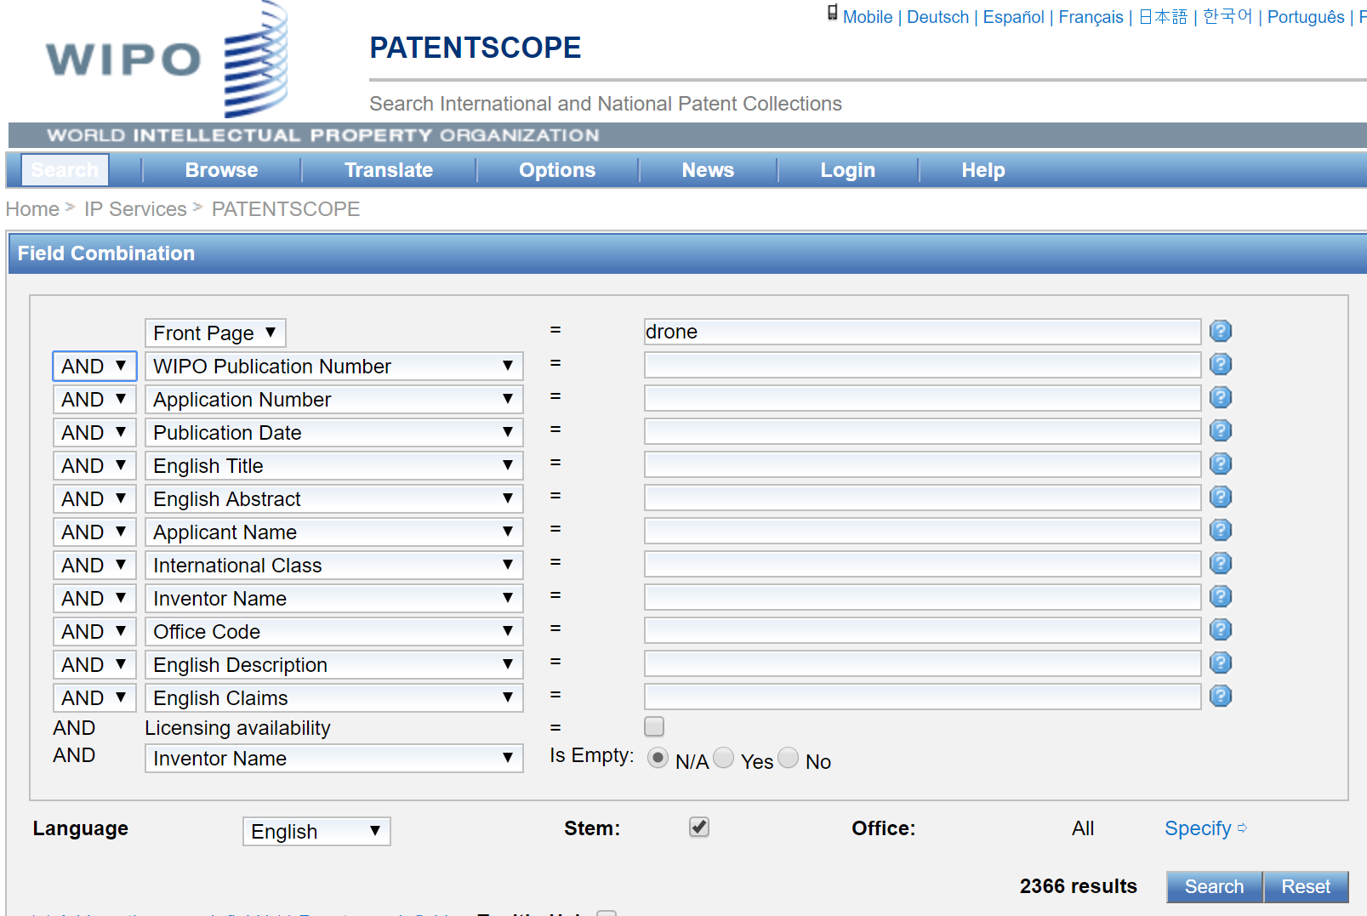
Looking in PATENTSCOPE for…drones
Drones
Drone

Slide 8
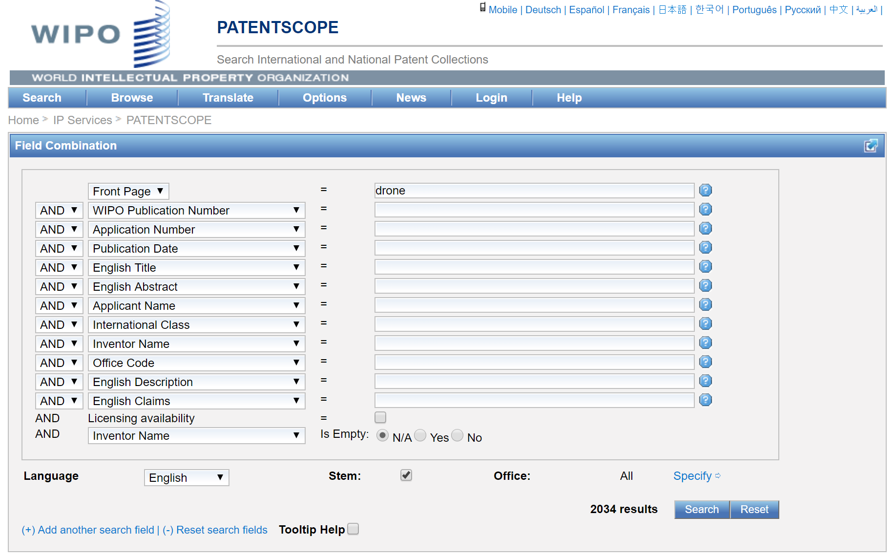
Looking for a drone in PATENTSCOPE

Slide 9
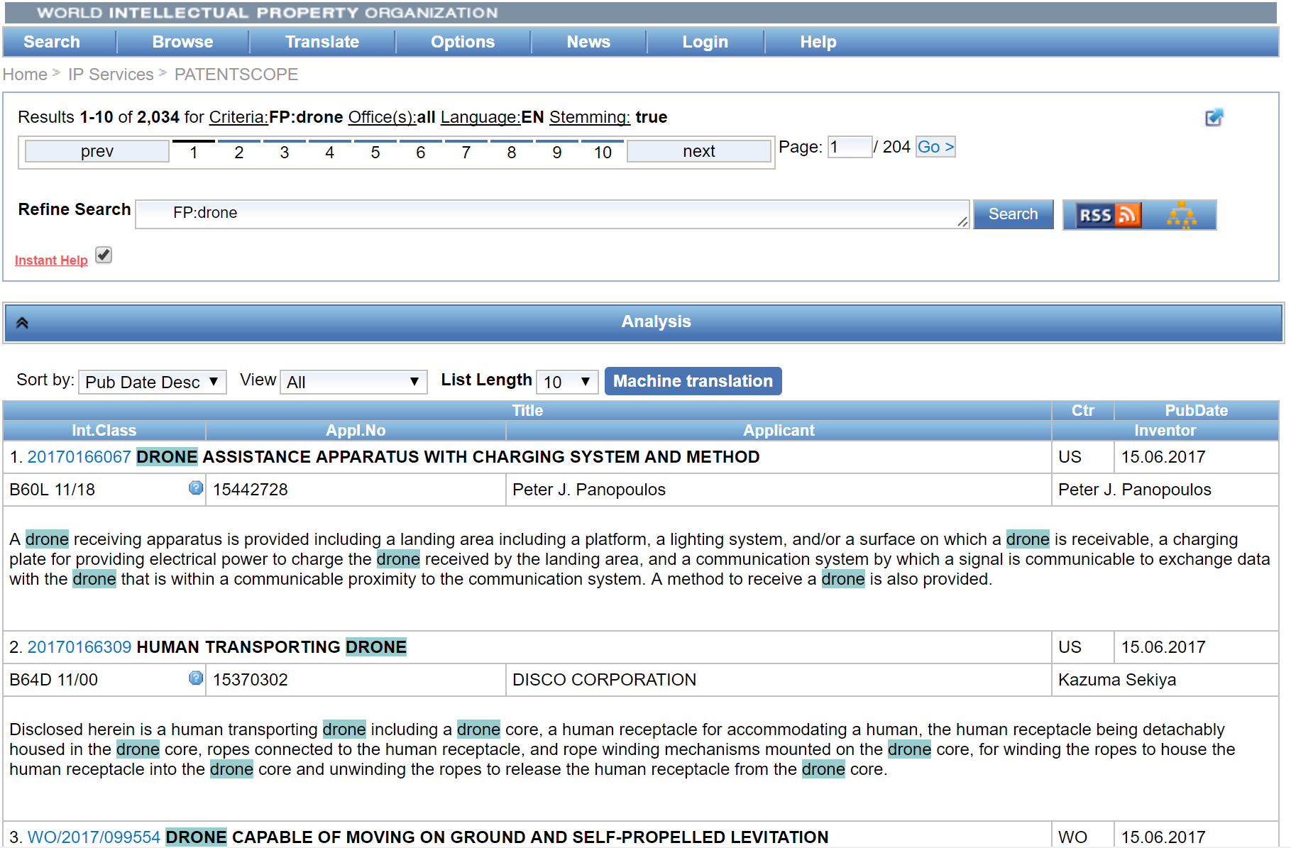
Search results on a list

Slide 10
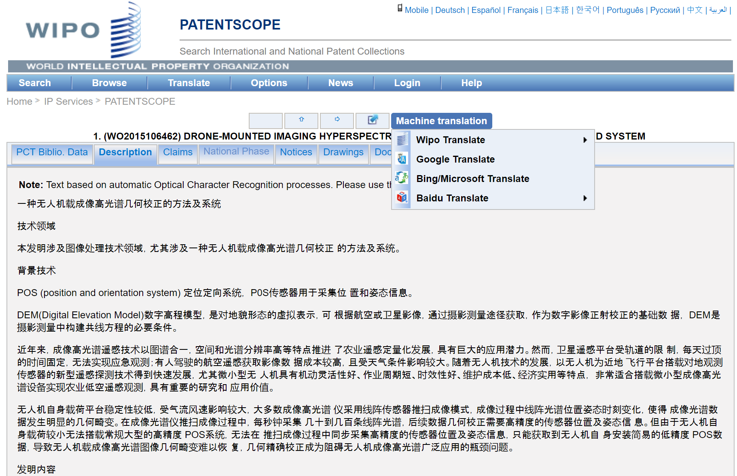
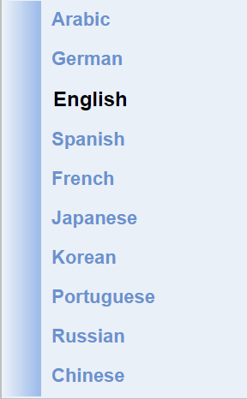
Looking closer at a search result

Slide 11
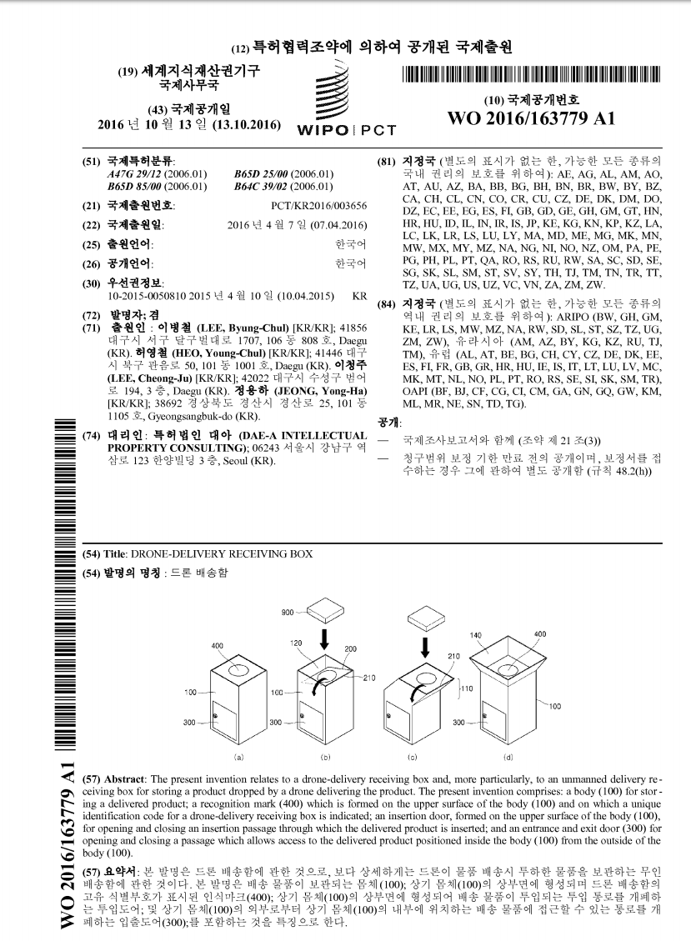
A PCT document in our results

Slide 12
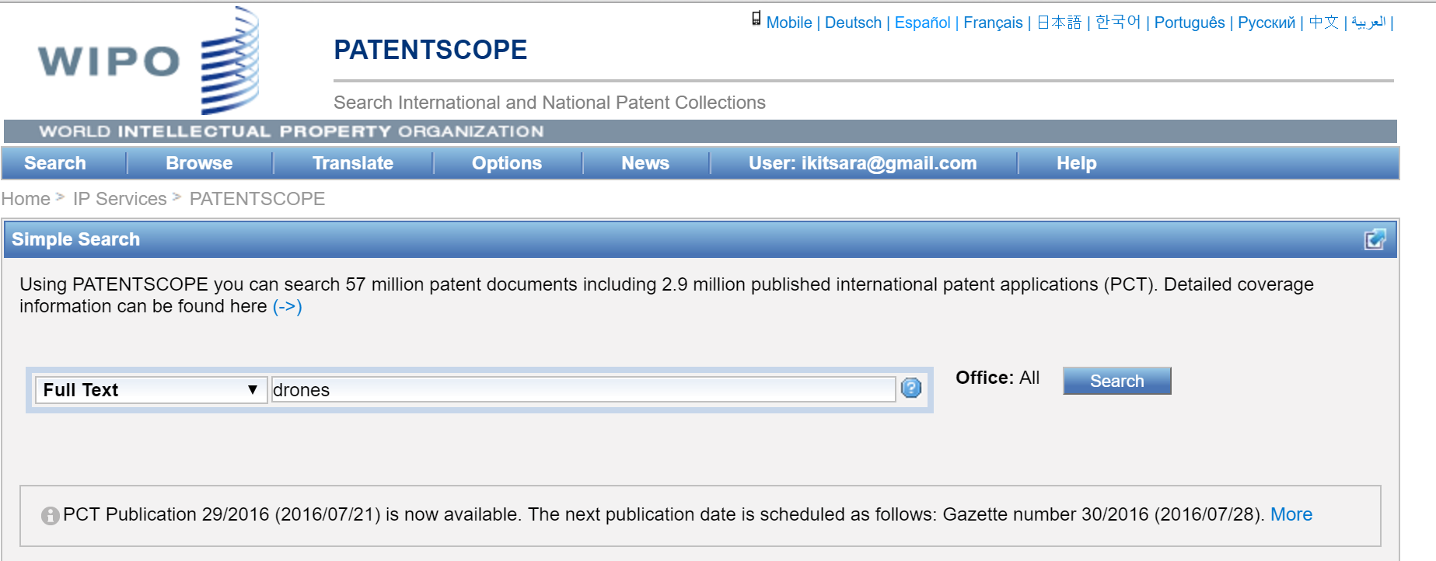
And if I were to look in full-text for drones?

Slide 13
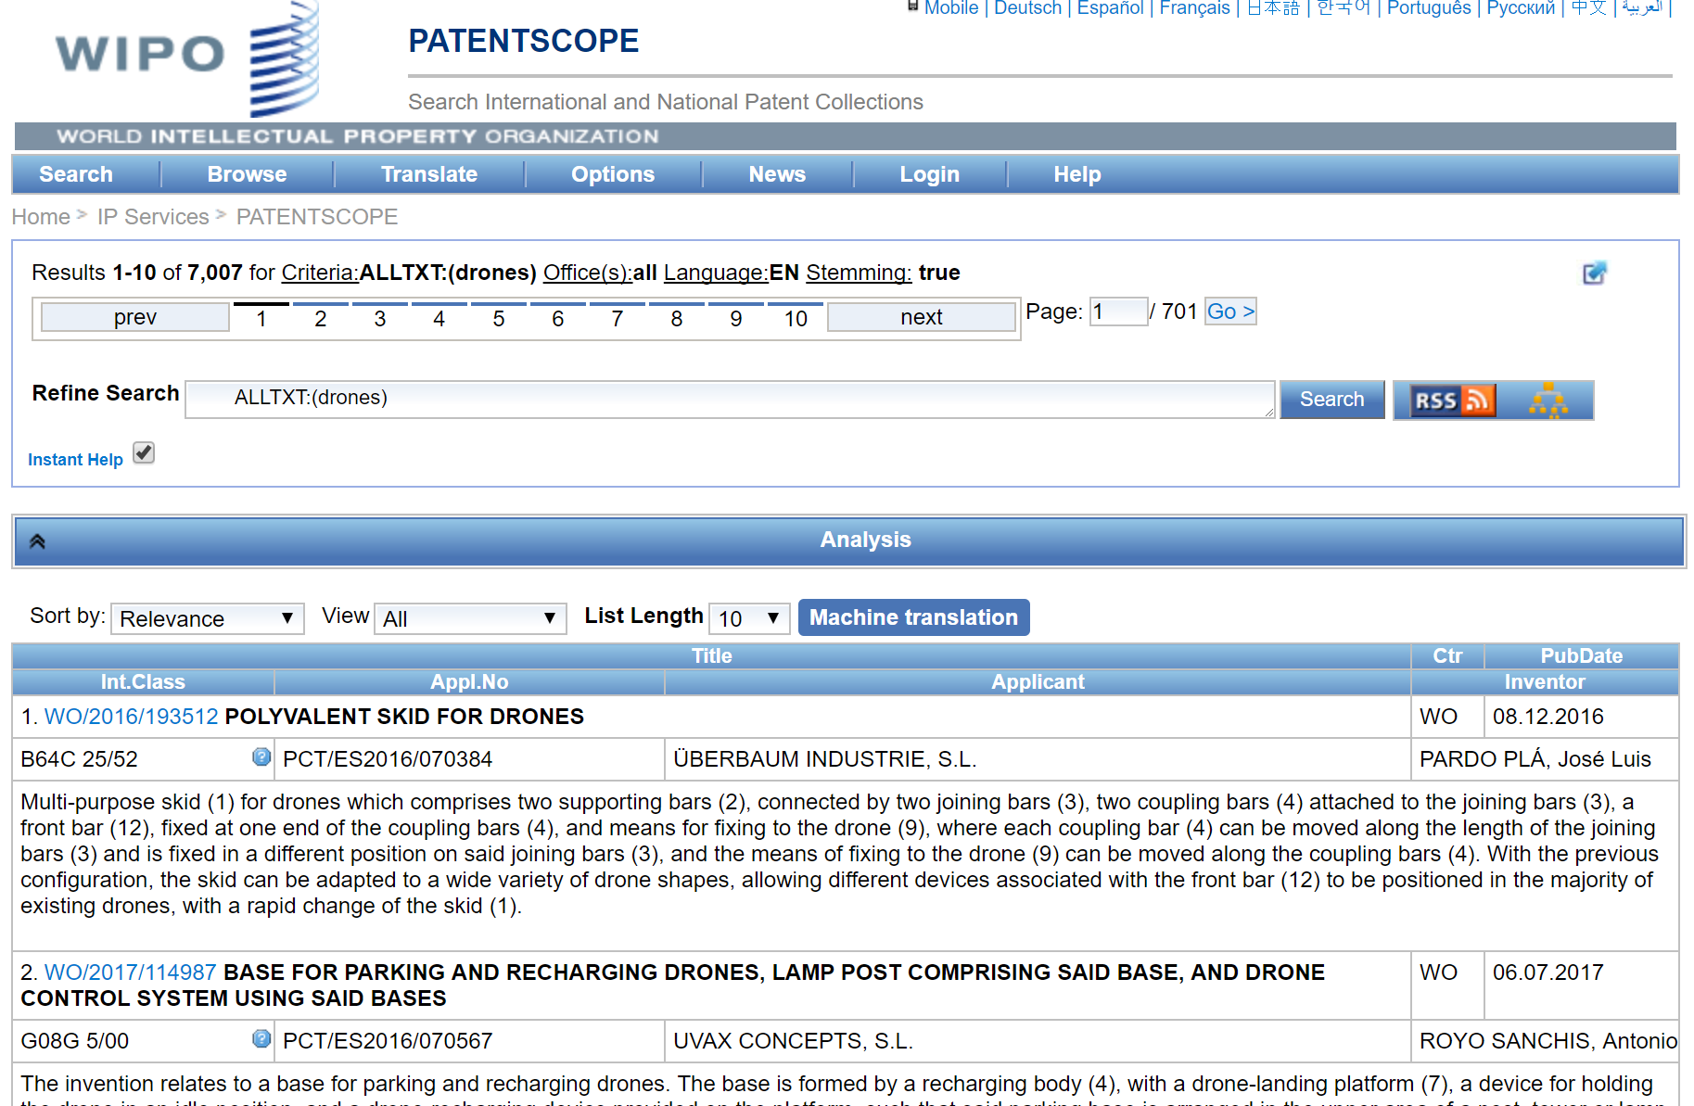
And if I were to look in full-text for drones?

Slide 14
Full-text « drone » vs. « drones »

Slide 15
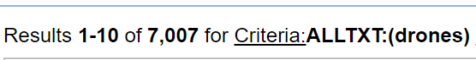

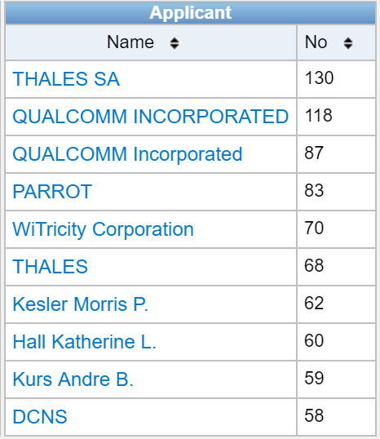
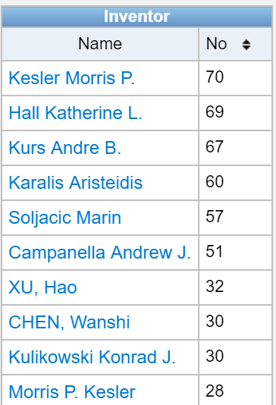
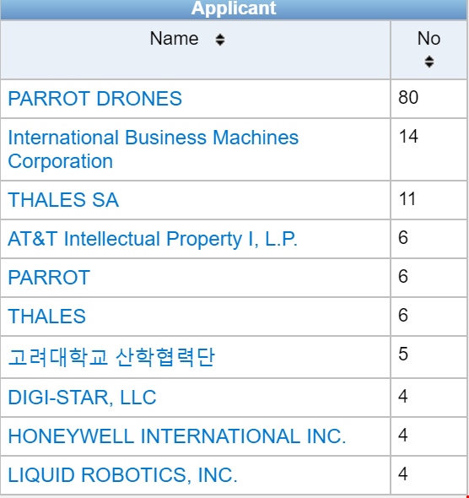
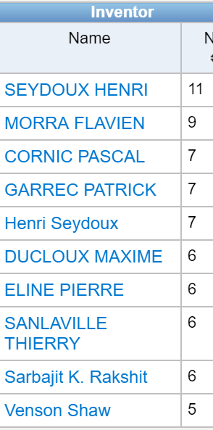
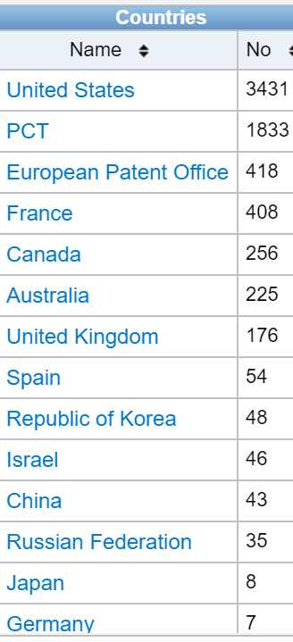
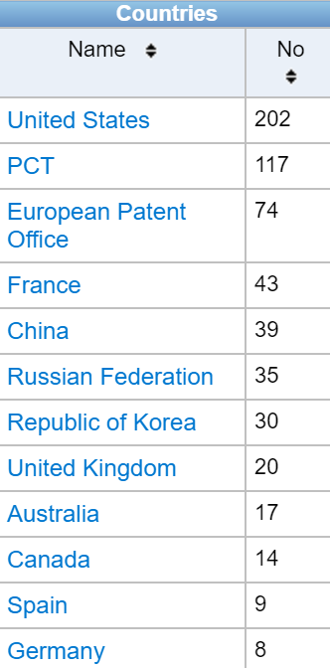
Let´s get a feeling of the data…
Front-page
Full-text

Slide 16
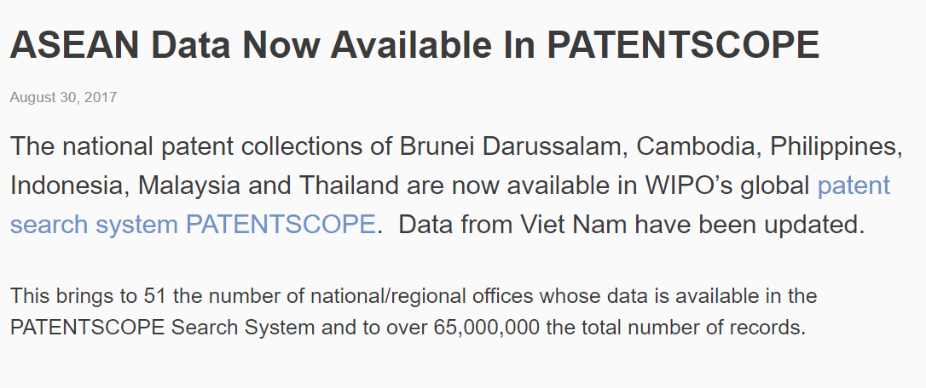
New PATENTSCOPE ASEAN coverage

Slide 17
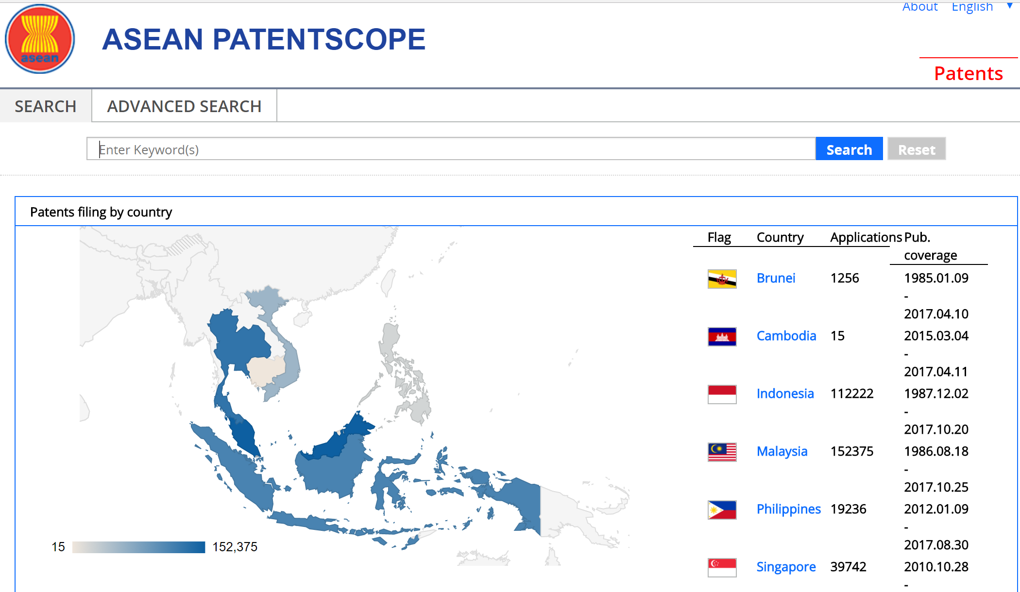
PATENTSCOPE ASEAN
http://ipsearch.aseanip.org

Slide 18
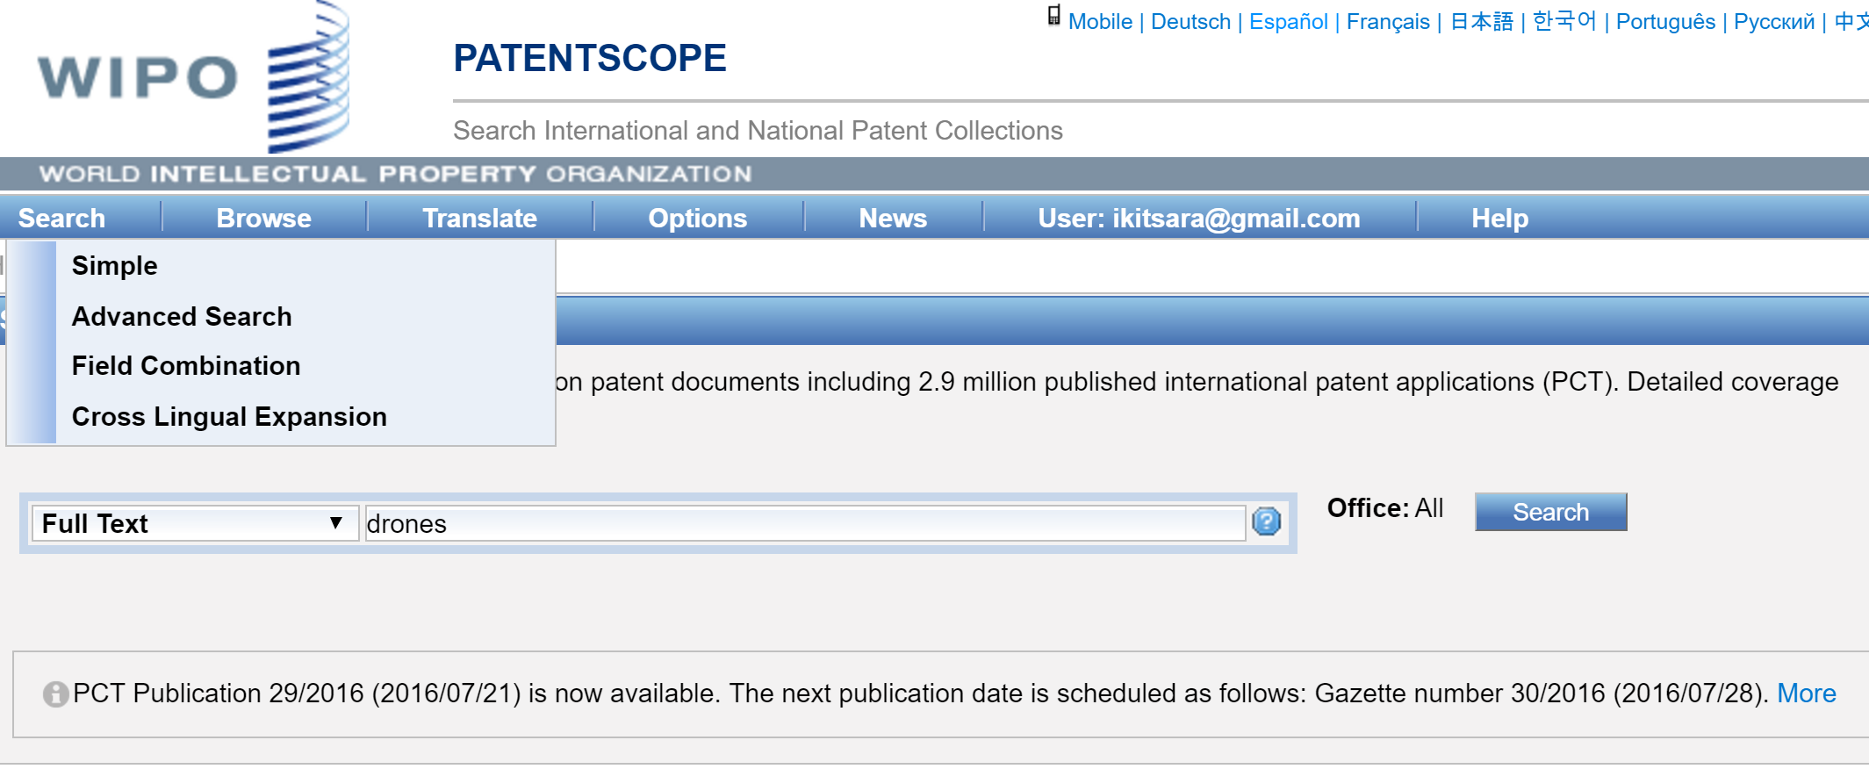
CLIR: Contributing towards more relevant data

Slide 19
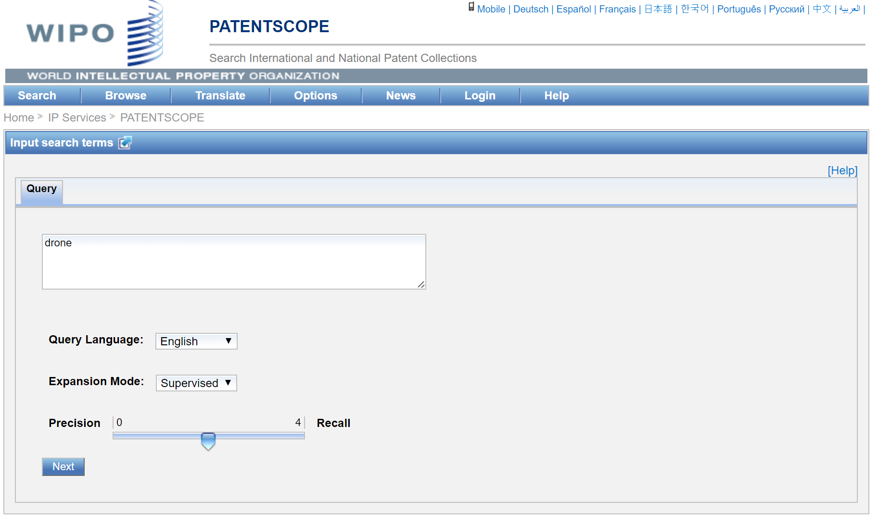
Drones on CLIR

Slide 20
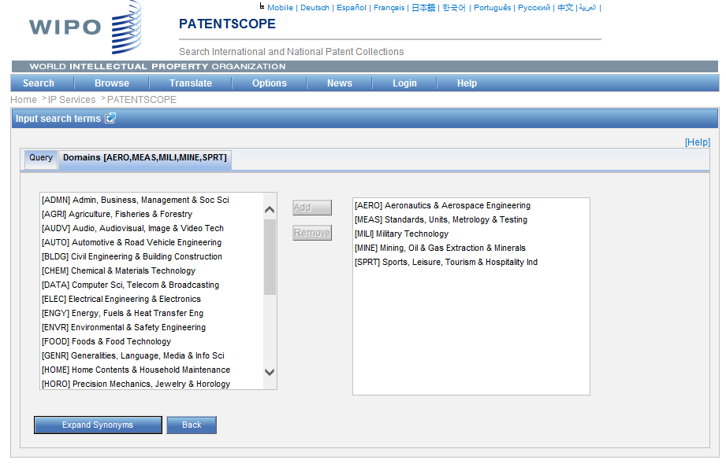
Supervised mode

Slide 21
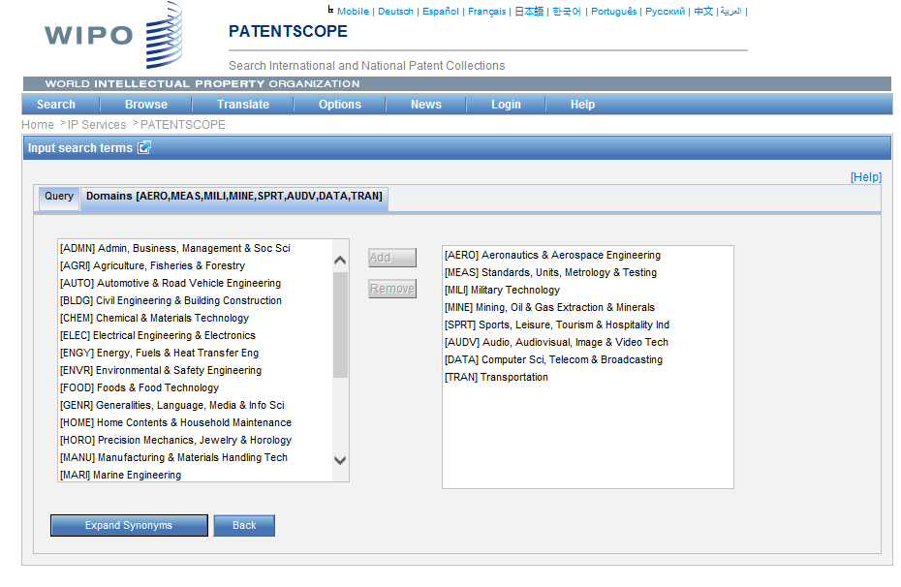
Added Technical Domains

Slide 22
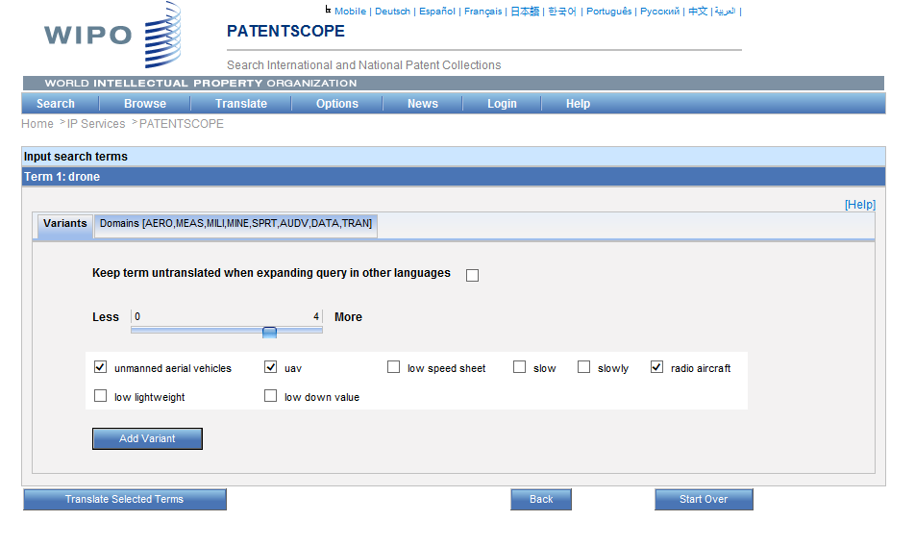
Addition of synonyms/variants

Slide 23
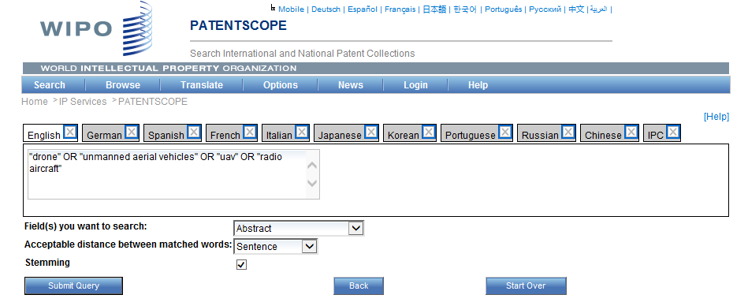
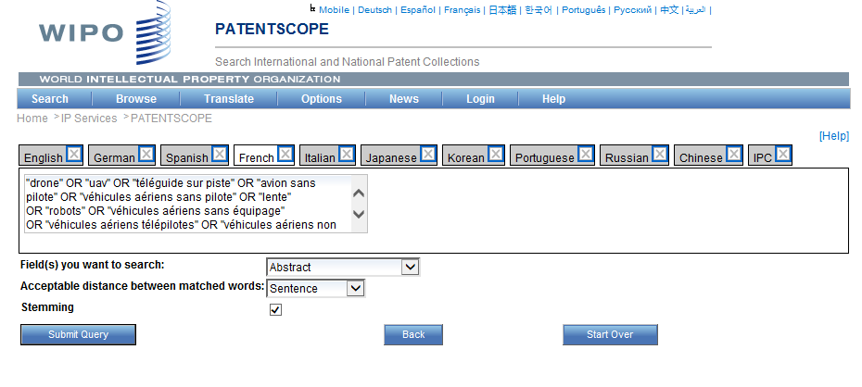
Selection of languages, fields, etc.

Slide 24
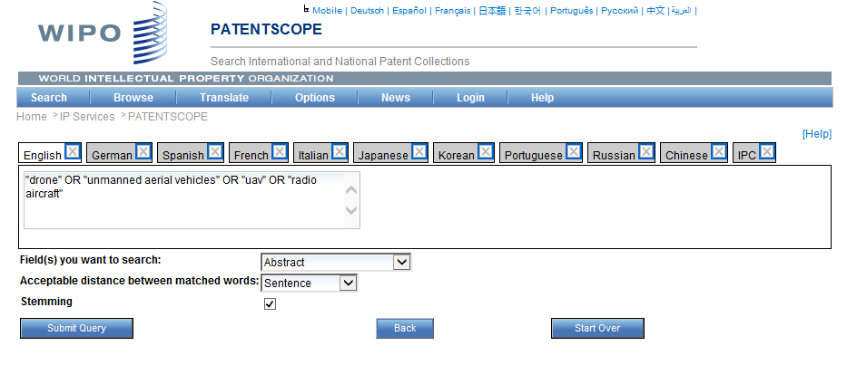
CLIR – Terms expansion

Slide 25
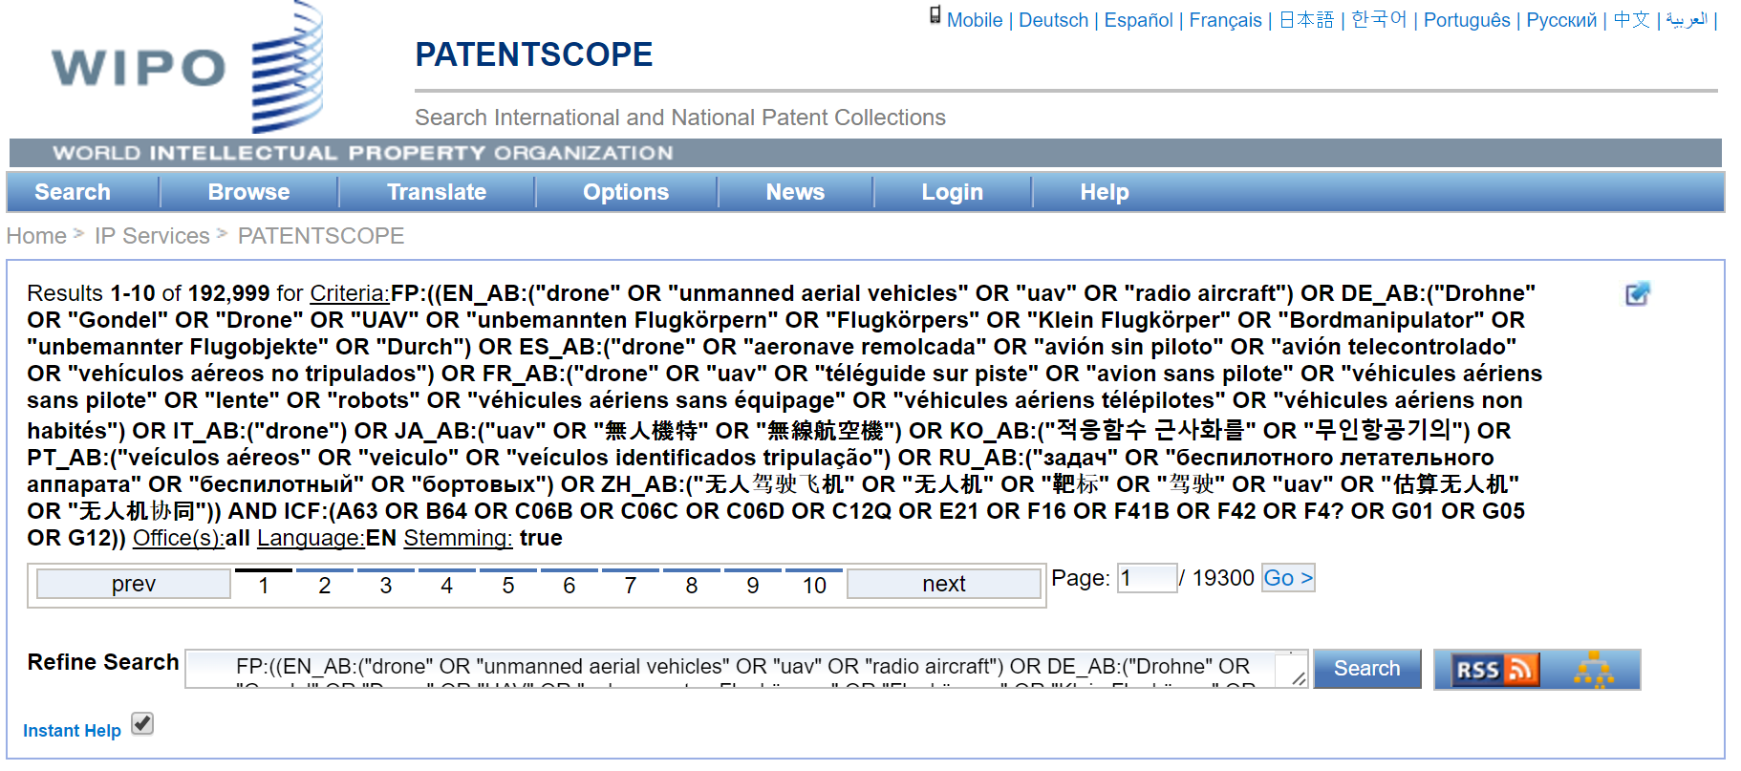
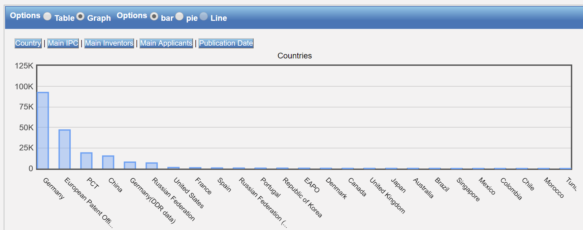
Results list and analysis

Slide 26
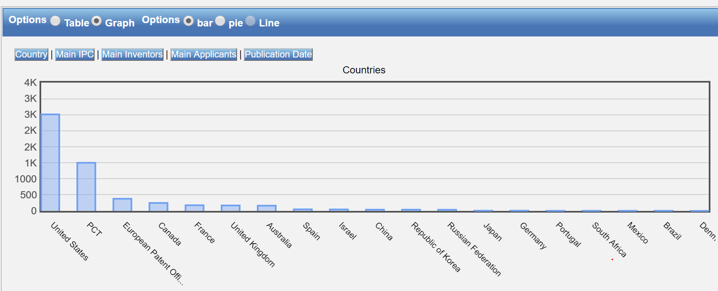

Slide 27
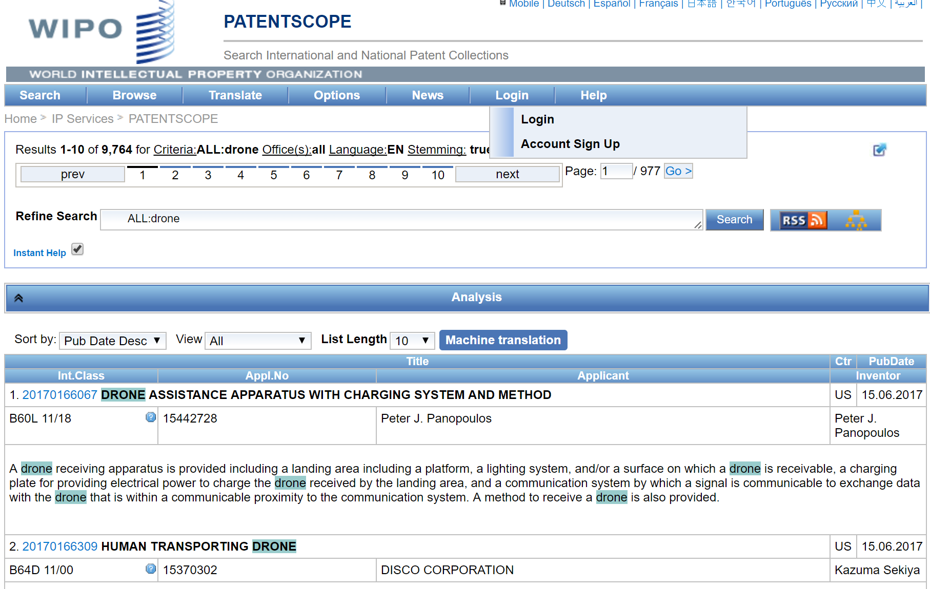
How do I export the data?

Slide 28
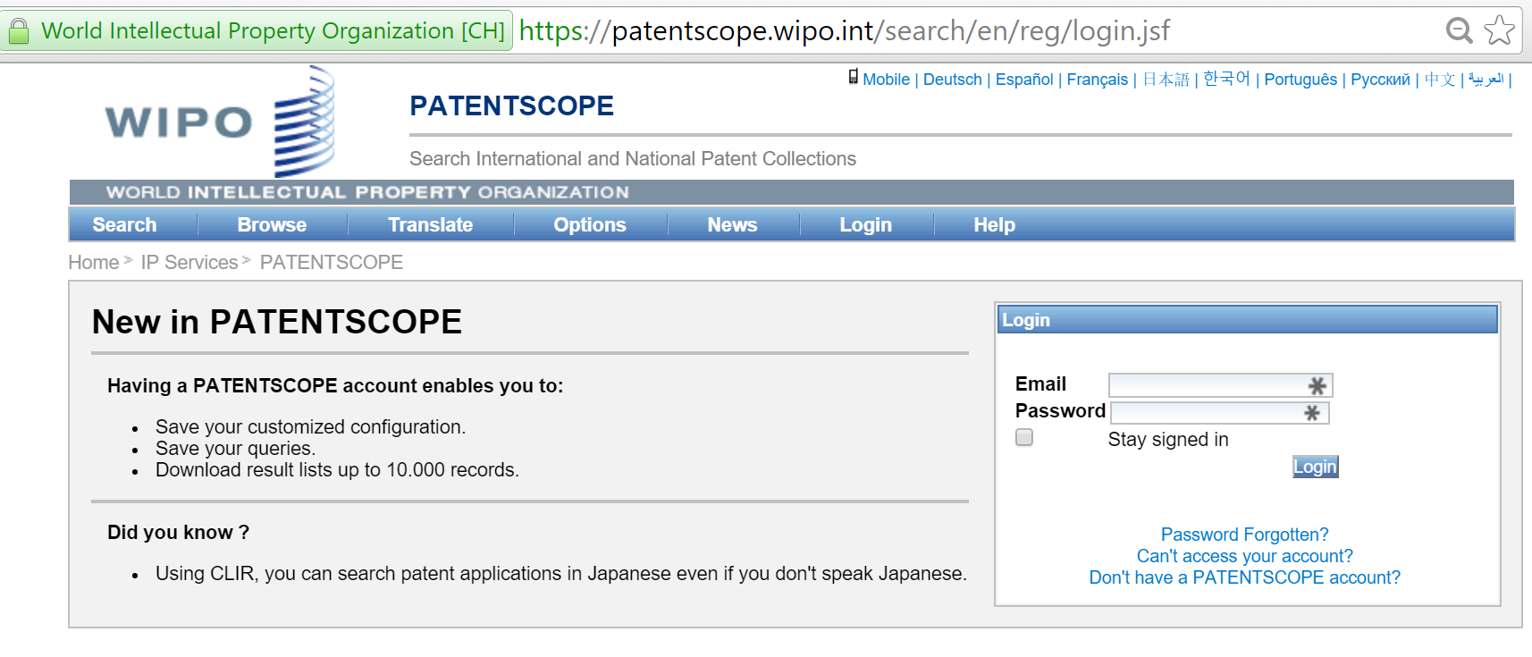
Create a PATENTSCOPE account

Slide 29
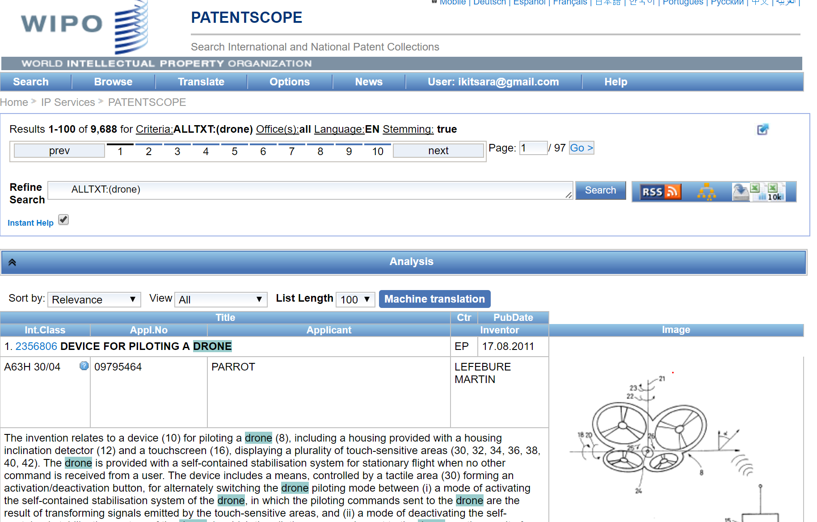
How do I export data from PATENTSCOPE?

Slide 30

Save and export
Save query
Export 100 results (with detailed data), with abstracts
Export 10,000 results (with less detailed data), yet with priority data

Slide 31
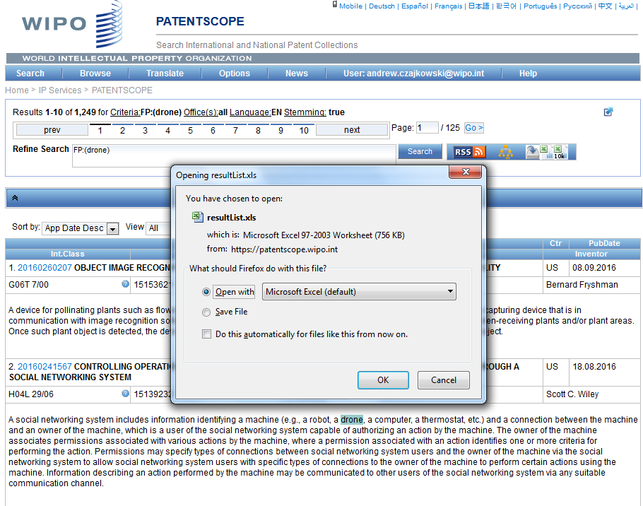
Export data to Excel

Slide 32
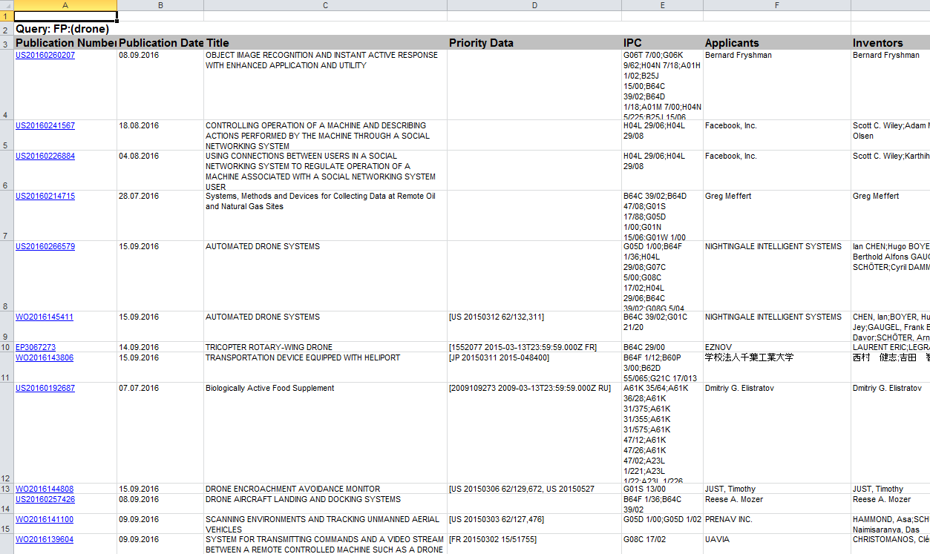
Excel Table with results list for FP:drone

Slide 33
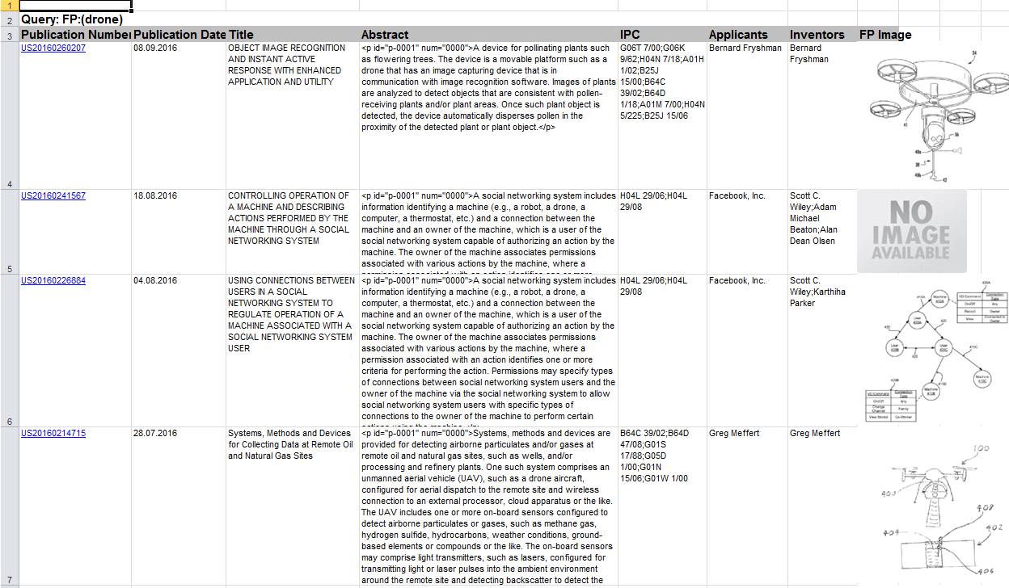
Example of detailed export (100 results)

Slide 34
Which information is being exported?
Publication Number – hyperlinked to the full patent document at PATENTSCOPE
Publication Date
Title
(Abstract – in 100 result list)
IPC
Applicants
Inventors
FP Image
Priority data (in long result list)

Slide 35
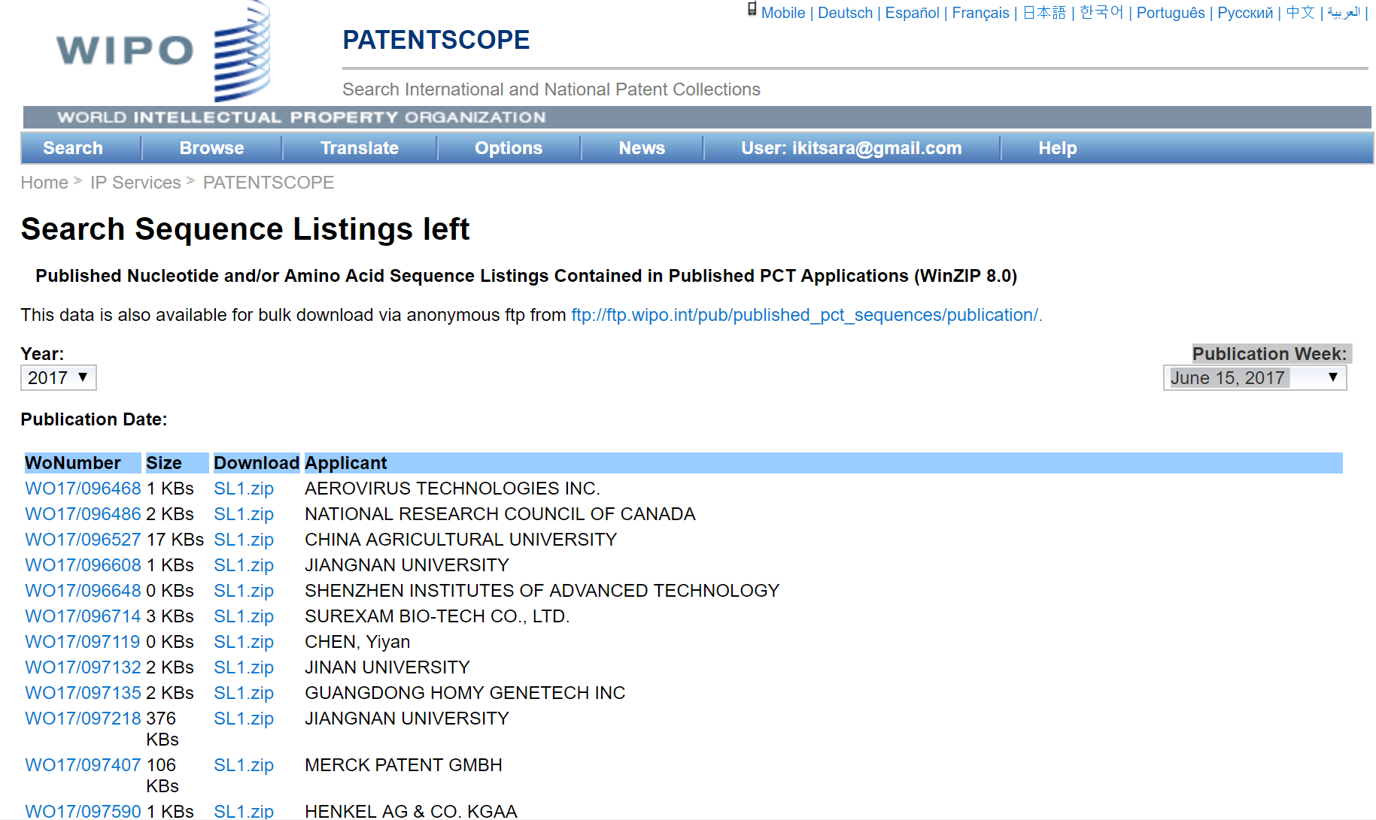
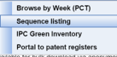
Sequence listings on PATENTSCOPE

Slide 36
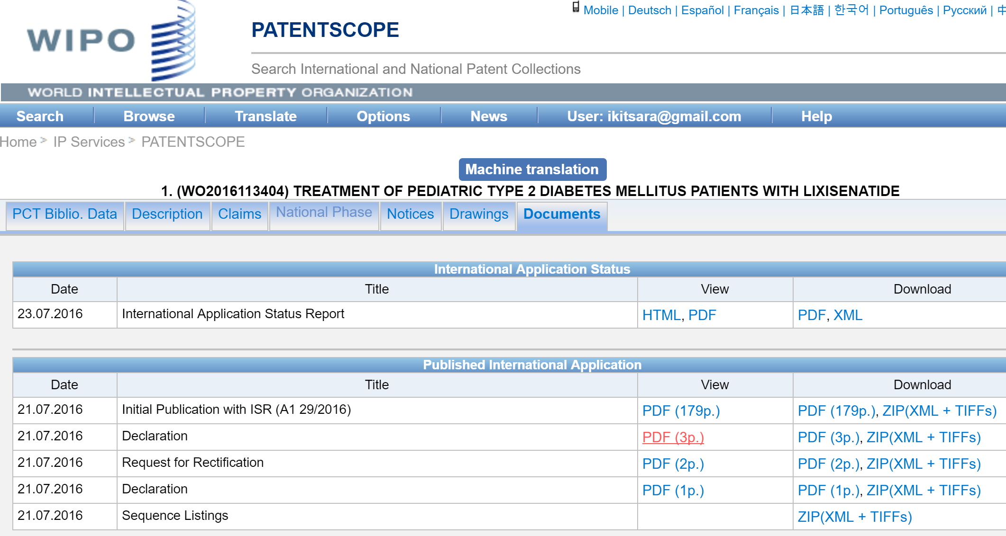
Access to sequence listings on individual patent documents and applicants

Slide 37
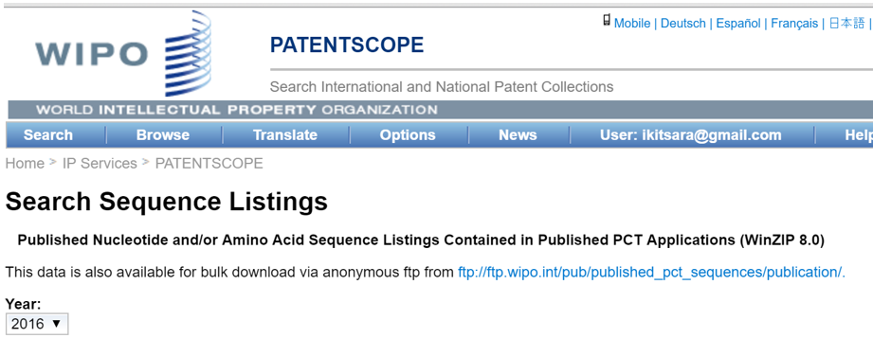
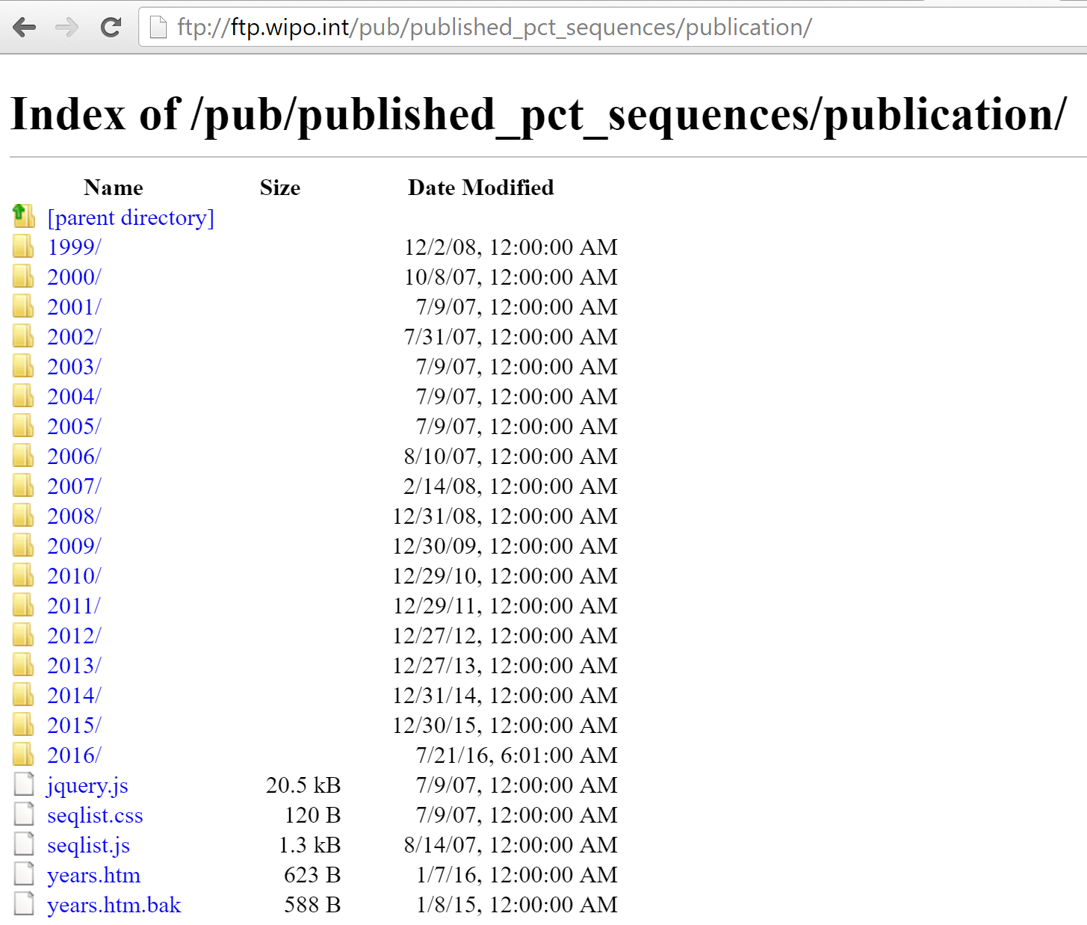
Exporting sequence listings from PATENTSCOPE
Bulk download also possible (anonymized FTP download – sequences by year if registered user)
.txt of sequence listings can create issues with data formatting

Slide 38
Irene.Kitsara@wipo.int

